Slide 1
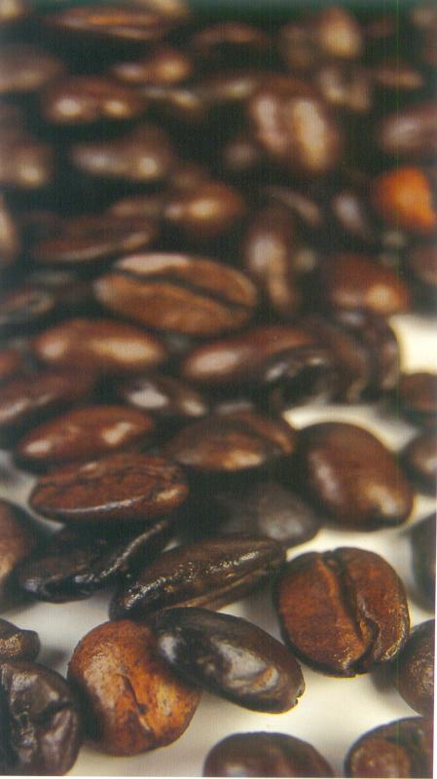
Black as hell,
Strong as Death,
Sweet as Love

Slide 2
ORIGIN
Derived from Turkish work ‘Kahve’ or Arabic word ‘Qahwah’ which means “Stimulating Drink”.
Was discovered in 3A.D by Kaldi an Abyssinian goatherd.
Botanical evidences suggests that coffee originated in Ethiopia.

Slide 3
ORIGIN
Spread in middle East through travelers and traders.
Spread in Holland through Dutch spies who smuggled beans. Got popularised in England, & Germany.
Reached America through Dutch colonisers.
Gained popularity in America after Boston Tea party.

Slide 4
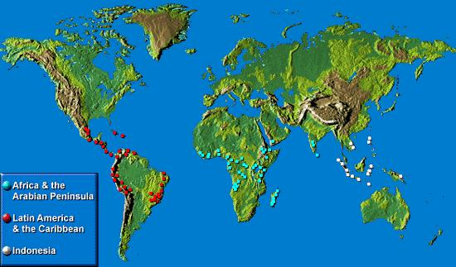

Slide 5
COFFEE GROWING NATION
Latin America
Caribbean
Africa
Arabian Peninsula
Indonesia

Slide 6
COFFEE PLANT
Three types of Coffee plants are grown for commercial purposes:
  Coffee Arabica-indigenous to Ethiopia,2000ft above sea level
  Coffee Robusta-indigenous to Congo, 2000ft below sea level
  Coffee Liberica-indigenous to Liberia.

Slide 7
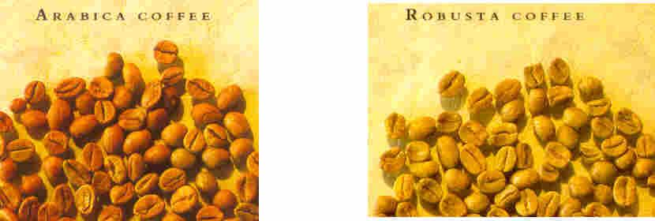

Slide 8
KNOW YOUR COFFEE BEAN!
Coffee plant grows in tropical regions with ideal temperature of 21-23 ºC.
It takes minimum 5-6 years for a plant to start yielding fruit. Has a life of 40 years.
Grows to a height of 30 ft, is pruned to 4-5 feet.
One single plant yields about 1 kg of coffee beans a year.

Slide 9
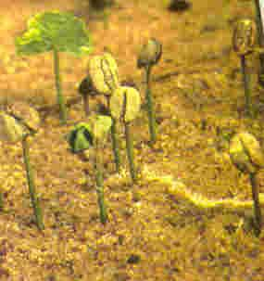

Slide 10
KNOW YOUR COFFEE BEAN!
Coffee seeds are planted in nursery and are grown for a few months and then transferred to pots or bags.
When they are a feet and a half they are planted in the plantation.
Coffee berries develop from flowers that blossom on the bushes.
Berries look like cherries. Turn from green to yellow to rich crimson.

Slide 11
KNOW YOUR COFFEE BEAN!
Just below the bean skin lies a thin membrane under which are two flat coffee beans.
Pea berry is that variety of coffee that has one berry.
Flavours and characteristic of coffee varies from place to place depending on the following factors:
  Climatic
  Topography
  Variety of plant
  Soil type

Slide 12
FROM PLANTATION TO CUP
HARVEST
CURING
ROASTING

Slide 13
FROM PLANTATION TO CUP
GRINDING
BLENDING
BREWING

Slide 14
HARVEST
Coffee berries ripen after 8-10 months after flowering.
In most countries with the exception of countries close to Equator, Coffee crops are harvested once a year.

Slide 15
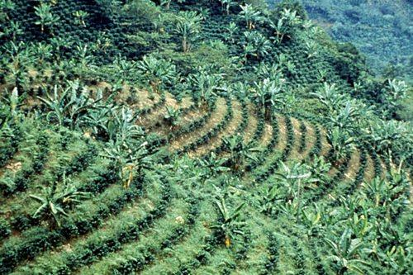
PLANTATION

Slide 16
HARVEST
Harvest - in North - April-August in South - September to December
Berries are harvest manually, they are hand picked or strip picked.

Slide 17
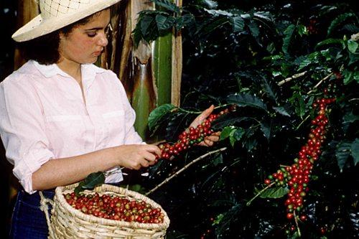
HARVEST

Slide 18
CURING
Once the berries are picked, they are process by two methods:
Wet Curing
  Flesh of berries are stripped.
  Berries are soaked in water for 12-36 hours, to loosen the sticky inner protective coat which envelops the parchments, this is removed and the berries are dried in sun.
  Huller removes dried parchment.

Slide 19
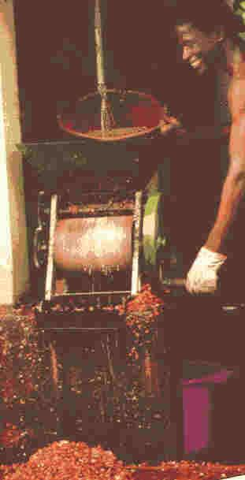

Slide 20
CURING
Dry Curing
  This is the older method of the two, more natural way of curing coffee.
  Berries are washed and dried in sunshine for 2-3 weeks.
  Finally the beans are put in milling machines to remove parchment.

Slide 21
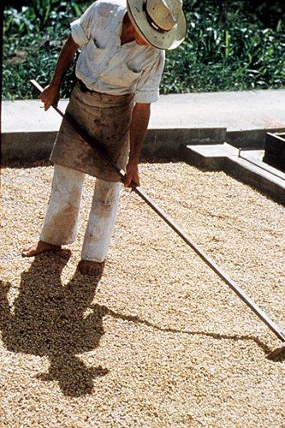
DRYING

Slide 22
SORTING AND GRADING
After being cured the beans are graded as per size, shape & weight of the beans.
As per grades, beans are packed in sacks.
Countries importing and exporting beans, prefer it unroasted.

Slide 23
ROASTING
Aroma of coffee is developed by the high temperatures to which the beans are subjected during roasting or broiling.
Temperatures are raised progressively to 200-220º C.
As a result of this process, 20% of water content is evaporated, starch converts to sugar and gases are released, thereby reducing weight between 14-23%

Slide 24
ROASTING
Beans become deep, rich and brown in colour, their texture becomes porous and crumbly.
Most important phenomenon that occurs at this stage is the development of aroma of coffee.

Slide 25
ROASTING
Roasting should be done evenly.
Over roasting can destroy flavours and aroma of coffee.
Under roasted beans produce flat and dull coffee.

Slide 26
ROASTING
In olden days coffee was rotated in a metal cylinder over a source of heat.
Hot air is propelled by blower into rotating metal cylinder containing the coffee, it ensures even roasting.

Slide 27
ROASTING
Coffee is immediately cooled in vats where it is continuously stirred and subjected to cold air propelled by a blower.
Good quality coffees are sorted by electronic sorter to eliminate seeds that are burnt or under done.

Slide 28
TYPES OF ROAST
Coffee roast differs from one another due to the the colour of the beans after being roasted.
  Light City Roast – Cinnamon coloured, light flavour
  City Roast – Light roast
  Full city roast – Dark brown, hearty flavoured.

Slide 29
TYPES OF ROAST
  Brazilian Roast – A shade darker than full city roast, has traces of oil.
  French City Roast – Burnt amber colour.
  Turkish Roast – Very dark coloured roast
  Italian Roast – Almost black in colour, yields darkest and heaviest coffees.

Slide 30
GRINDING
Usually coffee is bought without being ground.
Must always be ground immediately before consumption.
Industrial grinding happens in machines with serrated or scored rollers, set at progressively smaller gaps, that first cracks the bean and then cuts it into smaller particles desired.

Slide 31
GRINDING
The degree of fineness is important,
  If it is too coarse, water filters through too fast, does not pick up any flavours.
  If it is too fine, water filter too slowly, thereby retaining particles and making it too bitter.

Slide 32
GRINDING
In hotels or small scale grinding, coffee is ground in electric grinder or manual grinder.
There are various types of coffee grinds, meant for specific type of coffee.

Slide 33
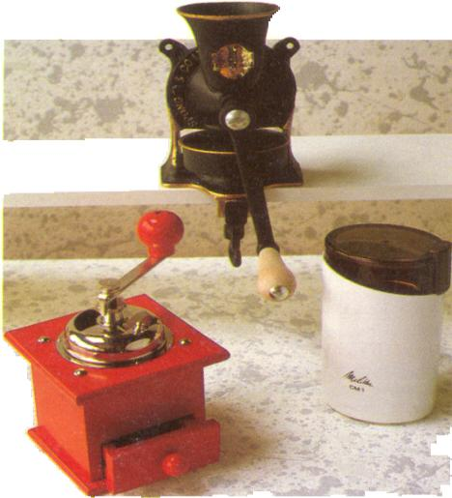
GRINDERS

Slide 34
TYPES OF GRIND
Pulverized – Very fine grind, used for Turkish coffee.
Very fine – Used for filter coffee.
Fine espresso – Used for espresso
Medium – Used for percolators, coffee jugs etc.
Coarse – For jug coffees only

Slide 35
BLENDING
Blending is carried out to:
  Enhance flavours of coffee
  produce uniform taste and flavour.
Can be done before or after grinding.
Arabica and Robusta blends very well.

Slide 36
BLENDING
Some planter also add chicory for blending.
Coffees can be made by blending 4-5 types of beans and as many as 12-15 types of beans.

Slide 37
PACKAGING
Is done in order to avoid moisture from reaching the coffee.
Coffee looses its aromatic qualities very rapidly, therefore must be stored in air tight containers or properly sealed packets.
Plastic packets, aluminum and other cellulose packaging is used to seal coffee.

Slide 38
TYPES OF COFFEE
Instant Coffee
Decaffeinated coffee
Flavoured coffee
Organic coffee

Slide 39
INSTANT COFFEE
Made by two methods:
  Freeze drying – Coffee is percolated and is frozen, moisture is removed through vaccum pump
  spray drying – Percolated coffee is passed through fine atomizer and the resulting air is subject to a blast of heated air, this causes water to evaporate leaving coffee powder

Slide 40
DECAFFEINATED COFFEE
Can be done by following methods:
  Beans are steamed to raise the moisture content, this brings the soluble caffeine to surface, which is washed by organic solvent such as Methylene Chloride.
  Another way is to water wash beans for long duration to remove caffeine.

Slide 41
FLAVOURED COFFEE
The tradition of flavouring coffees began in Middle East where coffees were flavoured with cinnamon and cardamoms.
Roasted beans are sprayed with oils carrying flavours.
Flavours are also infused in coffee through syrups such as vanilla, caramel, hazelnut etc.

Slide 42
ORGANIC COFFEE
Organic coffees are coffees that are cultivated without use of any pesticides, herbicides and fungicides.
They are very expensive as the production is limited as well as labour intensive.
Produced all over the world.

Slide 43
TYPES OF BREWS
  Jug Coffee
  Plunger or Cafetière
  Cona
  Neapolitan flip
  Filter
  Percolator
  Ibrik
  Espresso

Slide 44
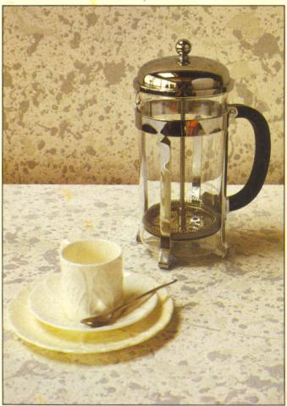
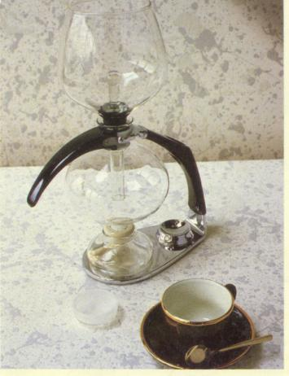
BREWING EQUIPMENT

Slide 45
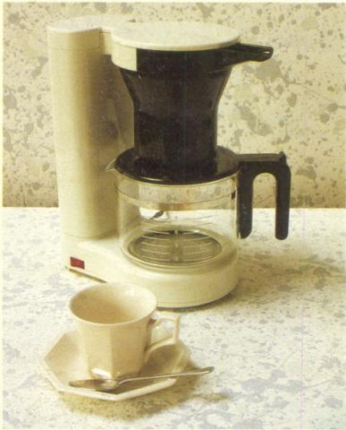
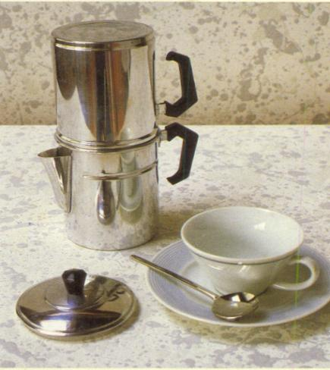
BREWING EQUIPMENT

Slide 46
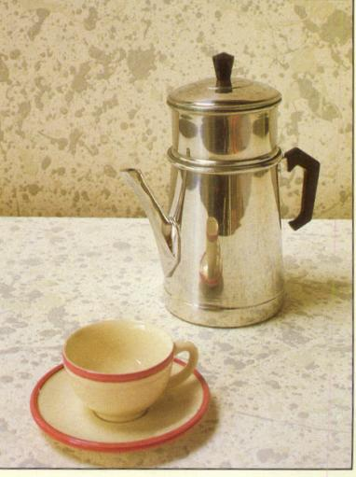
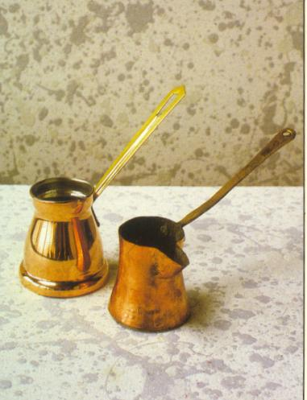
BREWING EQUIPMENT

Slide 47
COFFEE MENU
  Espresso/Single espresso/ Ristretto/ Italiano
  Double espresso/ Doppio
  Americano
  Lungo
  Cappuccino

Slide 48
COFFEE MENU
  Indian Espresso
  Romano
  Chocolaccino
  Café au lait
  Filter coffee
  South Indian Coffee

Slide 49
BREWING A CUP OF COFFEE
  Grind the beans immediately before making the coffee.
  Select the correct grind of coffee.
  Always used fresh water for brewing.
  The equipment must be clean and dry before use.

Slide 50
BREWING A CUP OF COFFEE
  Use approximately 2 tsp of coffee per cup.
  Always use fresh grind, do not reuse grounds.
  Warm pot and cup before serving coffee.
  Drink coffee as soon as it is ready.

Slide 51
REASONS FOR BAD COFFEE
  Weak coffee
    Insufficient coffee
    Incorrect temperature of water
    Stale coffee
    Incorrect grind

Slide 52
REASONS FOR BAD COFFEE
  Flat Coffee
    Coffee in urn for too long
    Dirty equipment
    Stale water
    Reheated coffee

Slide 53
REASONS FOR BAD COFFEE
  Bitter Coffee
    Excess coffee powder
    Long Infusion
    Incorrect roasting
    Temperature of infusion too high

Slide 54
STORAGE OF COFFEE
  Air tight containers, away from moisture.
  Stored in form of beans, ground before service.
  Ground coffee should be consumed within a week.
  Never store with highly flavoured items, stored in cool dry and dark place.

Slide 55
COFFEES AT OBEROI HOTELS
  Serves café au lait, Cappuccino, Espresso, Filter, Instant, South Indian and Decaffeinated coffee.
  We also serve Irish Coffee, Jamaican Coffee and Mexican Coffee.
  The machines used are ‘EGRO’ and ‘CIMBALLI’

Slide 56
COFFEE BRANDS AT OBEROI HOTELS
  Nescafe Select
  Möven pick
  Lavazza
  Coorg Coffee beans

Slide 57
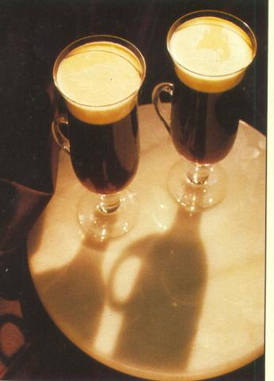
OTHER COFFEES
  Irish Coffee
  Mexican Coffee
  Calypso coffee

